Slide 1
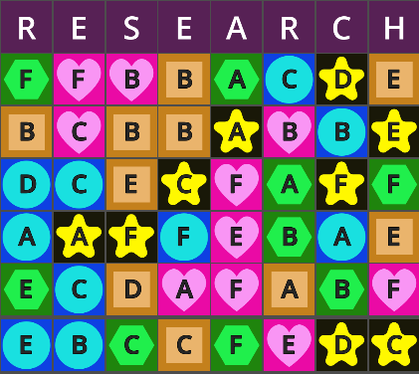
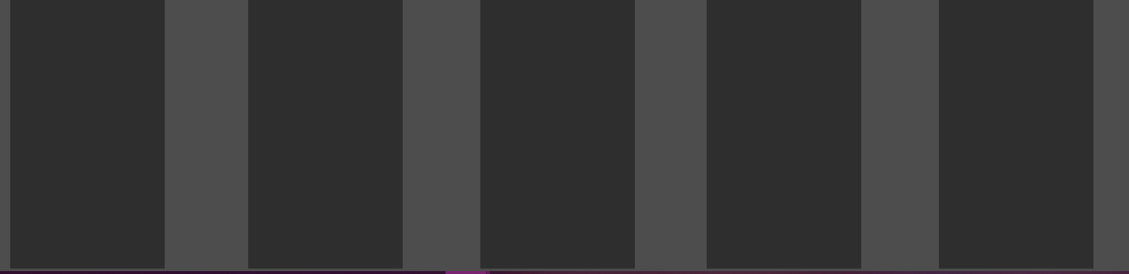

Goal
Place all tiles into active experiments
(to win there must be no tiles in research, storage or inactive experiments)
Your final setup must follow all alchemical laws

Slide 2

Research
Only tiles in the bottom row are available to be taken
After taking a tile from the bottom row, it will be replaced by the next one above it in the same column
Tiles taken from research must be placed into one of your experiments or storage
You are locked from taking new tiles if any of your experiments are unstable

Slide 3

Storage
Tiles can be freely placed into or out of storage.
Storage is never subject to alchemic laws
Storage has a capacity of 8
Storage starts with 2 random tiles

Slide 4
Experiments
You have 5 experiments that can each hold any number of tiles
Tiles can be moved between experiments freely
Experiments are inactive when they have less than 3 tiles
Inactive experiments are automatically stable
Active experiments are stable only if they do not violate any alchemical laws. If it breaks any laws, it is unstable (blocking victory and taking new tiles from research)
The laws of Alchemy apply separately to both the shapes and letters in an experiment
Each experiment is a separate set that does not contribute to the shape and letter counts relevant to other experiments
When an experiment has at least 3 tiles, it becomes active:
All active experiments are subject to alchemical laws

Slide 5
Meta Constraints
Eventually, both alchemical laws will also apply to the number of tiles each active experiment has
In other words, two active experiments can not have the same number of tiles and one experiment can not have more tiles than all the other active experiments combined
These constraints do not apply until there are at least 20 tiles in your active experiments
When meta constraints are broken, all experiments become unstable

Slide 6
All active experiments are subject to alchemical laws
Experiments are only active if they have at least 3 essences in them
Inactive experiments are automatically considered stable
Active experiments are stable only if they do not violate any alchemical laws
The laws of Alchemy apply separately to both shapes and letters
Alchemy law #1
Alchemy law #2
(anti-equality rule)
An experiment can not have an equal count of two different shapes
An experiment can not have an equal count of two different letters
(anti-majority rule)
An experiment can not have more of any shape than all its other shapes combined
An experiment can not have more of any letter than all its other letters combined

Slide 7









Tiles
Each tile has 2 attributes:
ELEMENT:
Element Types
LETTER: Each essence is randomly generated with a letter A-F,
There is no guaranteed amount for any letter

